Slide 1
COVID Trend Analysis
A ML MODEL to detect & predict which STATES are more vulnerable to CoVID-19 based on the data provided!!!
MADE BY : Kartik saini(UE178051)
AAKANKSHA grover(UE178001)

Slide 2
What this model does?
It is a COVID Predictor ML model in which we can predict no. of CONFIRMED cases, no. of RECOVERED cases & no. of DECREASED cases for various states on the upcoming days, by using Polynomial Regression.

Slide 3
What WE DID
Initially, we divided the data (105 tuples) into training set (85 tuples) & test set (18 tuples).
Training set contains CONFIRMED cases from 14th March 2020 to 7th June 2020 & we predicted the test set after 7th June 2020 to 25th June 2020 by using Polynomial Regression.
Based on the data on the training set, we used polynomial degree of 2 for ODISHA & got a MAPE (Mean Absolute Percentage Error) of 1.19%.
Also we used polynomial degree of 4 for ANDAMAN AND NICOBAR & got a MAPE (Mean Absolute Percentage Error) of 5.11%.
Polynomial Degree is chosen precisely after careful observation that the model doesn’t remain underfit or doesn’t overfit.

Slide 4
OBSERVATIONS

Slide 5
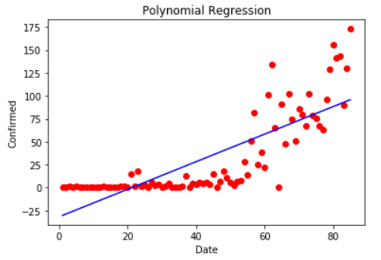
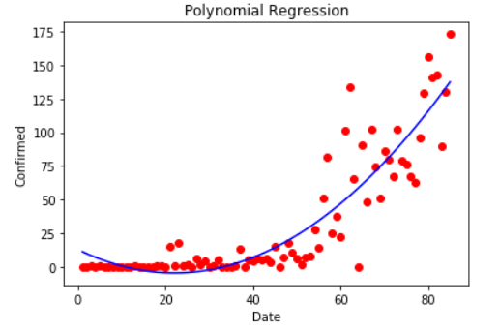
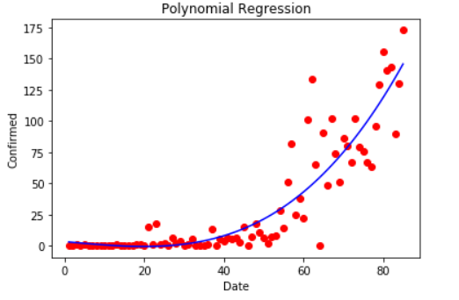
ODISHA
Degree : 1
MAPE : 2.0336982185018244 %
UNDERFIT
Degree : 2
MAPE : 1.193031408742935 %
BEST
Degree : 3
MAPE : 1.6062102024754954 %
OVERFIT

Slide 6
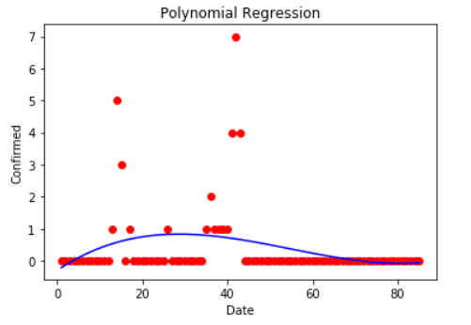
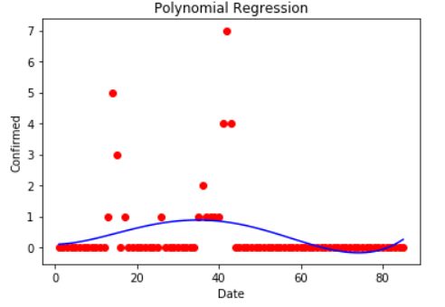
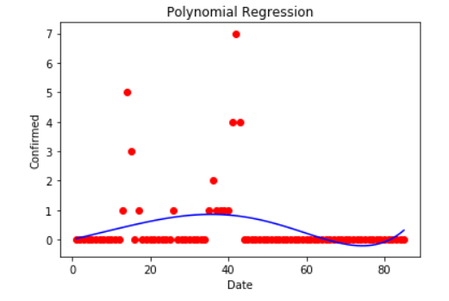
ANDAMAN AND NICOBAR
Degree : 3
MAPE : 5.555555555555555 %
UNDERFIT
Degree : 4
MAPE : 5.111111111111111 %
BEST
Degree : 5
MAPE : 6.222222222222222 %
OVERFIT

Slide 7
Predicted datasets
ODISHA :- https://docs.google.com/spreadsheets/d/1at4Fw61fk0IgrsO5JxAc2bEV_UxCTSJ8z026GFwIWcs/edit?usp=sharing
ANDAMAN AND NICOBAR :-
https://docs.google.com/spreadsheets/d/1nMyCVwkc_Rc7VJN31H4tp5Ad3Blo8M7J29w68yW9FD0/edit?usp=sharing
DELHI :-
https://docs.google.com/spreadsheets/d/1UVy83VKuDx-tzYKY8QA-olE4vCSoNSoqyMYGIKbTASE/edit?usp=sharing

Slide 8
THANK YOU

